Slide 1
COMP 598 FINAL PROJECT Classification Analysis of Parkinson Speech Dataset
Shu Hayakawa
Elcin Ergin
Timardeep Kaur

Slide 2
Problem definition
Parkinson disease diagnosis from speech impairments
Need for remote monitoring of patients
Substantial opportunities for lowering the inconvenience and cost of physical visits
Need for reliable clinical monitoring tools
Approximately 90% of PWP (People with Parkinson) exhibit some form of vocal impairment
dysphonia (defective use of the voice),
hypophonia (reduced volume)
monotone (reduced pitch range)
dysarthia (difficulty with articulation of sounds or syllables)

Slide 3
Data
26 voice samples from each subject
vowels, numbers, words, and short sentences
Train data:
20 PWP (6 female, 14 male)
20 healthy individuals (10 female, 10 male)
Test data:
28 PWP
Sustained vowels (“a” and “o”)

Slide 4
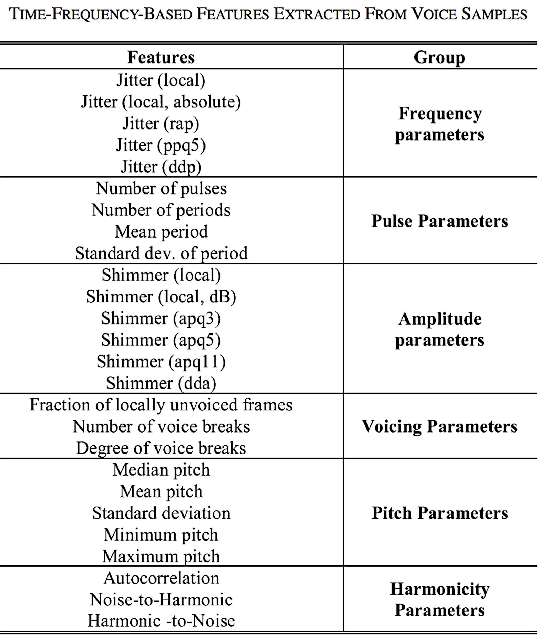
Data

Slide 5
Related Work
Sakar, Betul Erdogdu, et al. - binary classification
Methods:
SVM
K-NN
Leave-One-Subject-Out
Validation: all the voice samples of one individual is left out
Training: the rest
Leave-One-Out
Summarized-leave-one-out
Central tendency metrics:
Mean, median, trimmed mean
Dispersion metrics:
Standard deviation, mean absolute deviation, interquartile range

Slide 6
Methodology
Replication of the results
Methods to be applied
Logistic Regression
K-NN
SVM
Linear
Non-linear
Leave-one-subject-out
Leave-one-out
With summarized features
Regularization
Lasso
If time permits
Testing with other datasets

Slide 7
Preliminary Results
Leave-one-subject-out validation results:
 | Accuracy
Logistic Regression (Stochastic gradient search) | 55%
SVM | 52.5%
K-NN | 42.5%

Slide 8
References
Sakar, Betul Erdogdu, et al. "Collection and analysis of a Parkinson speech dataset with multiple types of sound recordings." Biomedical and Health Informatics, IEEE Journal of 17.4 (2013): 828-834.

Slide 9
THANKS

